Slide 1


Slide 2
Any questions during or after session please text us at:
519-437-9059

Slide 3
For Your Family’s Sake
Farm Business Succession is a journey not an event

Slide 4

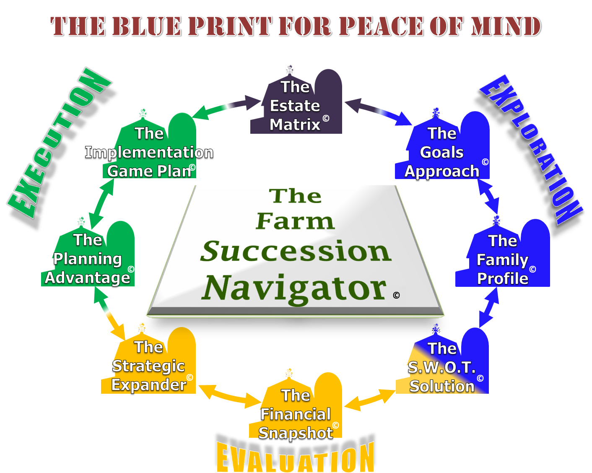
Farm Succession Plans
Our Planning Process

Slide 5
Goals and Dreams
Founders’ Personal Goals
Successors’ Personal Goals
Founders’ Business Goals
Successors’ Business Goals
Are they compatible

Slide 6
Comparison by Member

Slide 7
Farm Succession Plans
Our Planning Process

Slide 8
S.W.O.T.

Slide 9
Business Plan
Clear Vision
Gives business owners a common goal
Establish SMART Goals
Improves communication

Slide 10
Risk Management
Minimize
    Have some loans on float, some fixed
Eliminate
    Do not grow that crop
Diversify
    Store assets in two different locations
Transfer to insurance
    Disability Insurance
Assume

Slide 11
Financial Analysis
Funding for your retirement lifestyle
    How much you will need?
    Where it will come from?
    Will I run out and if I do is there a Plan “B”?
    What about non farm child?

Slide 12
$48,000 after taxes-2% Inflation
Year | Living Costs | Taxes | Total Outflow | C.P.P. | O.A.S. | From Farm Corporation
2014 | $51,957 | $3,243 | $55,200 | $7,779 | $13,689 | $33,722
2021 | $59,682 | $3,725 | $63,407 | $8.936 | $15,735 | $38,736
2028 | $68,556 | $4,279 | $72,835 | $10,264 | $18,075 | $44,496
2035 | $78,749 | $4,915 | $83,665 | $11,790 | $20,762 | $51,112

Slide 13
Financial Analysis
Current financial analysis of the farm business
    Snap Shot of where you are today
    Projected cash flow
    Projected accrued income
    Key financial Ratios
    Snap shot of where the farm would be at transition

Slide 14
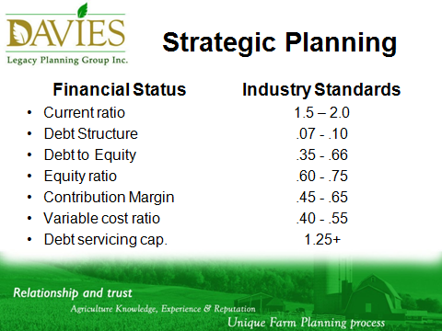

Slide 15
Estate Equalization
Net worth of farm when child started on farm
Net worth of farm in 2011
Net worth of farm at death

Slide 16
Estate Analysis
 | 2013 | 2020 | 2027 | 2034 | 2041
Shares | $5,214,966 | $4,752,880 | $4,520,880 | $4,257,843 | $3,729,746
House |  | $363,256 | $384,469 | $407,391 | $449,772
Total | $5,214,966 | $3,016,136 | $4,905,349 | $4,665,334 | $4,179,518

Slide 17
Identification of Skills
Time Management
Human Resources
Negotiation Skills
Team Building
Working with People
Planning
Financial Skills
Networking Skills
Marketing
Analytical Skills
Communication
Selling Skills

Slide 18
TRANSFER OF ROLES AND RESPONSIBILITIES
ROLE | CURRENT | FUTURE | DATE | CRITERIA
Herd Health | Don | Jason | 2019 | -mentoring -experience
Breeding | GenCor | Jason | 2016 | -experience (John)
Sire Selection | GenCor | Jason | 2018
Culling | Don | Dan | 2017
Feeding | Don | Dan | 2018
Hoof | Don | Dan/Jason | 2017
Calf Management | Don | Jason | 2016
Building & Equipment | Don | Scot | 2018 | -get or trade
Crop Input | Don | Jason | 2017 | -Innovative Farmers -SWAC -FarmSense
Equipment | Don | Scott | 2018
Crop Rotation | Don | Jason/Scott/Dan | 2025
Bookkeeping | Jeanette | Outsider | 2025 | -I-Cloud
Financial Management | Don/Jeanette | Jason | 2017 | -business plan -C.O.P. -Cash flows -Advanced Farm Management Program -CTEAM -FCC Dairy workshops -US Dairy seminar

Slide 19
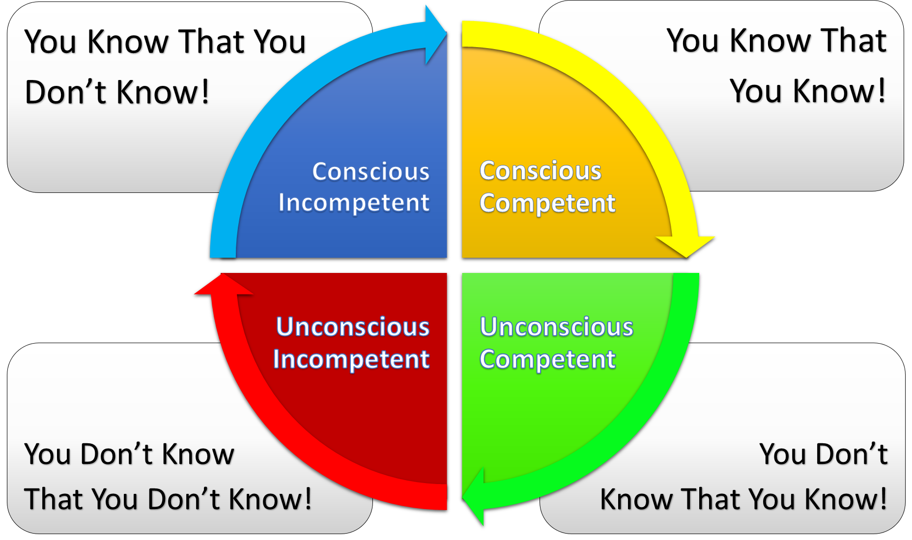
Recognize the need for Change

Slide 20
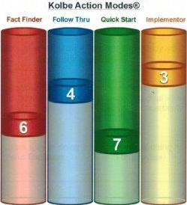
Kolbe Index
Kolbe A Index for
Len Davies

Slide 21
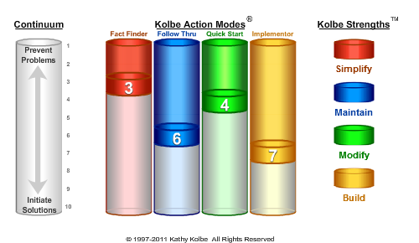
Kolbe Index
Kolbe A Index for
Jeff Davies

Slide 22
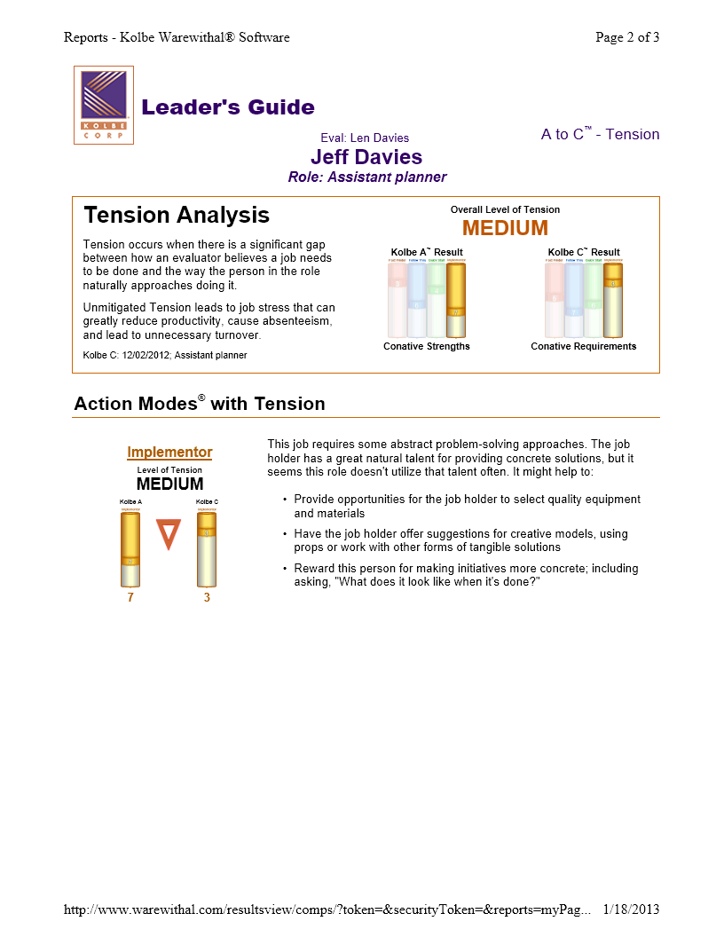
Kolbe Index
Kolbe C Index

Slide 23
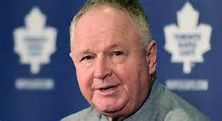
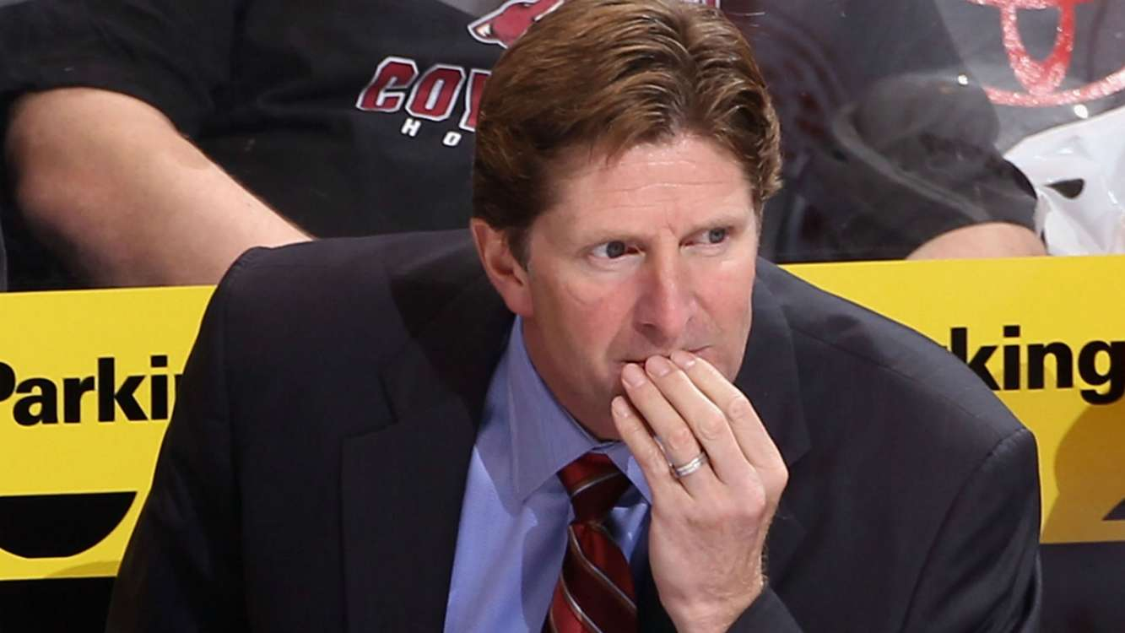
Managing Relationships
Managing Relationships
Randy Carlyle previous coach
Mike Babcock coach 2015-16

Slide 24

James Reimer

Slide 25

Managing Relationships
Coach Maple Leafs to 2015
Reimer during Carlyle coaching

Slide 26

Managing Relationships
Positive Re-affirmation
Best Save Percentage early 2016

Slide 27
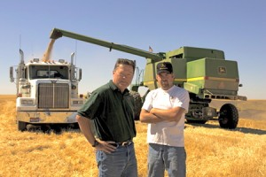
Managing Relationships
I know my stuff
There is more than one way

Slide 28
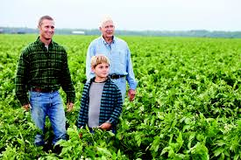
Positive Re-affirmation
Big Picture thinkers

Slide 29


Desired results
He is finally out of my hair
Let’s work together

Slide 30
 | Present | Beginning of Transition | Midway through Transition | Transition Complete | Later in Life
Management | Parents | Parents / Successor | Successor | Successor | Successor
Growth | Parents | Parents | Parents / Successor | Successor | Successor
Ownership | Parents | Parents | Parents | Parents / Successor | Successor
Control | Parents | Parents | Parents | Parents | Parents / Successor

Slide 31
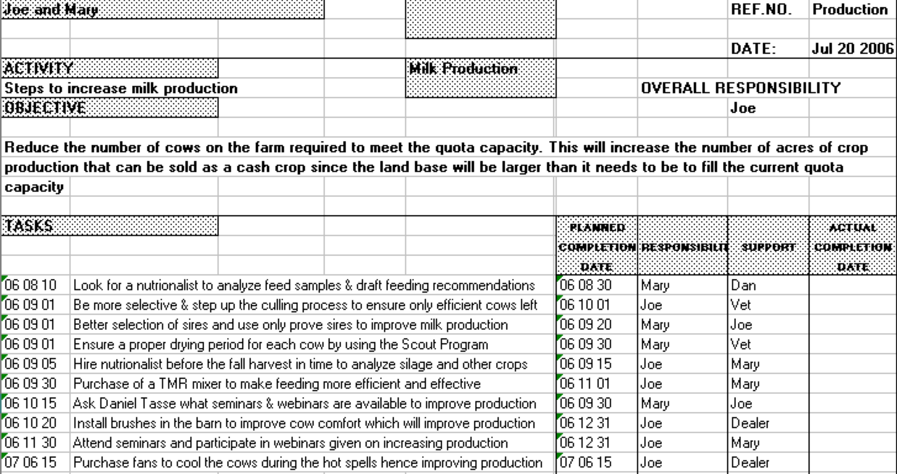
Activity Plans

Slide 32
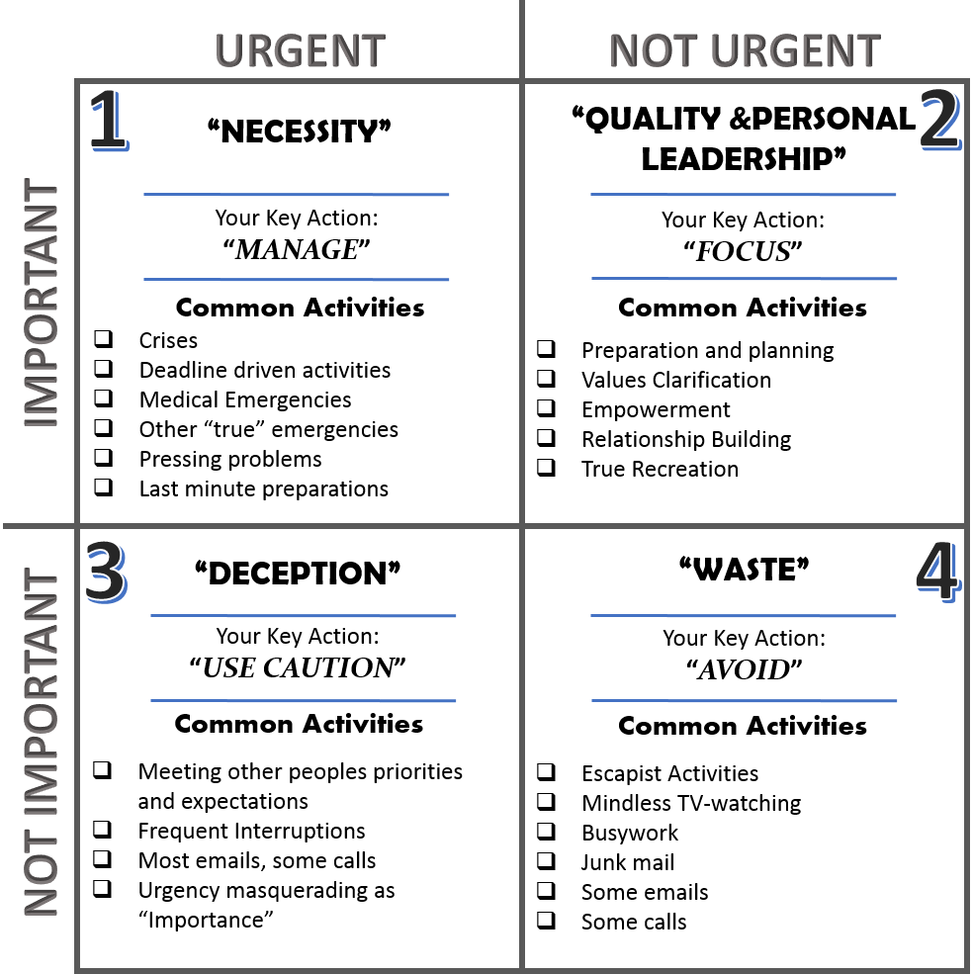
Time Management

Slide 33
Farm Advisory Team
You
Lender
Marketer
Valued Advisor
Crop Consultant
Accountant

Slide 34
Family Business Communication
Someone to Champion the meeting process
Set time and place for meeting
Ask everyone for input into agenda
Circulate agenda
Make sure up to date financials are presented
Ensure Activity plans are up to date.

Slide 35
Types of Ownership
Corporation
Sole Proprietorship
Partnership
Capital Partnership
Joint Venture

Slide 36
Corporation-2016
Restructure the shares of the corporation
Farm is worth $2,000,000 and owes $400,000
Founder’s Equity $1,600,000
Lender
$400,000

Slide 37
Corporation-2016
Restructure the shares of the corporation
Farm is worth $2,000,000 and owes $400,000
Founders Equity $1,600,000
Frozen Shares
Lender
$400,000
New Entrant $1
Growth Share

Slide 38
Corporation-2021
5 years-farm worth $2,400,000, cash $50,000 & debt $300,000
Corporation bought $50,000 shares each year for 5 yrs.
Corporation made $10,000 per year and is in corporation
Founder’s Equity $1,350,000
Frozen Shares
Lender
$300,000
New Entrant $850,000 of
Growing Shares

Slide 39
New Entrant’s Equity
The new entrant’s equity is reflected in his grow shares. The company has paid him/her a salary as well as anyone else who worked on the farm. Extra funds were used to pay $50,000 per yr. to by founders’ shares
Inflation of $400,000
Debt reduction of $100,000
Purchase of owner’s shares $250,000
Cash or assets purchased from cash $50,000
Total value of new entrant’s growth share is $850,00

Slide 40
Corporation-2016
Restructure the shares of the corporation
Farm is worth $2,000,000 and owes $400,000
Founder’s Equity $1,600,000
Lender
$400,000

Slide 41
Corporation-2016 (New Entrant has $150,000)
Restructure the shares of the corporation
Farm is worth $2,000,000 and owed $400,000
Founder wants $500,000 up front new entrant has $150,000
Founders Equity $1,100,000
Frozen Shares
Lender
$750,000
New Entrant as lender
$150,000
New Entrant $1
Growth Share

Slide 42
Capital Partnership
New Concept
  Similar to corporation but no shares & New Entrant buys founders’ units
  Growth would go to:
    Partnership Growth Units
    Partnership Income Units
Check with a knowledgeable tax specialist for feasibility in your circumstance

Slide 43
Partnership
Each party brings something to the partnership
Partnership receives all income- pays all expenses
Excess goes into an equity account which is tracked every year.

Slide 44
Partnership
Founding Owner
New Entrant
Partnership
Equity Accounts for all Partners

Slide 45
Equity Accounts
Month | Original Owner | New Entrant
January | $3,000 | $2,000
February | $3,000 | $2,000
March
--------- | -------- | --------
December | $3,000 | $2,000
Year end Totals | $36,000 | $24,000
Amount Available | $40,000 | $40,000
Balance in equity account | $4,000 | $16,000

Slide 46
Partnerships
Pros
Easy to get in and out of
Flexible
Good for start up
No WSIB for partners
No unemployment
Cons
Liability for each other
Not as formal as corp.
Not as tax effective
Could take longer to build equity

Slide 47
Joint Venture
Designed for two entities that have something to offer
Much like a partnership in that both entities work together
Set up as a short term arrangement

Slide 48
Income Sharing i.e. Sharecropper
Owner supplies the assets
New entrant supplies the labour
100% sharing to build saving & experience
100% sharing with right to purchase
New Entrant could have a small entity - needs more income so income shares with 3rd party

Slide 49
Sole Proprietorship
Usually sale for fair market value with vendor holding mortgage
Allows for a menu of financing alternatives
Could be an issue with Capital Gains tax up front
Not very flexible but secure

Slide 50
Contingency Planning
The “5 D’s” of Contingency Planning
Death
Disability
Dissolving shares
Divorce
Disagreement

Slide 51
Death of a Parent
What happens when a parent(s) pass?
Who owns what?
What do non-farm children receive (Fairness)?
How is estate fairness funded?
Testamentary agreement between parents?
Who runs (manages) the business

Slide 52
Death of the Farm Child
Management of the business?
In business with in-laws new partner?
Is an in-law bought out, if so –what value?
How is it funded?
Does it differ now compared to 20 years?

Slide 53
Disability
Is there a difference between mental and physical impairment?
Is it different if just child and parent involved compared to siblings owning the business?
Who calls the shot if voting power is in hands of Power of Attorney who is not the farm operator

Slide 54
Disability
Disability insurance available to fund living?
Should there be an optional buy-out?
If so when is it implemented?
What triggers an optional buy-out?
What does funding look like?
Where does the disabled person live?

Slide 55
Dissolving Shares
How is a value determined?
  Fair market value
    One appraiser, two and use average??
  Shot-gun clause
  Lawyer acts as auctioneer
A child who exits early is entitled to ????

Slide 56
Dissolving Shares
Funding of buy-out
In case of death life insurance best alternative
If funded by borrowed funds be creative:
  An amount up front that the farm can afford
  Payments 2-5 yrs.-20 yr. amortization rate, prime +
  At year 2-5 balance due
  Using 25 year loan just spread it over 27-30 yrs.

Slide 57
Divorce
Domestic Agreement
Trusts
Gifts after marriages
Inheritances
Sale - full market value parent holds mortgage

Slide 58
Domestic Contract
Always remember:
Your goals are similar:
  What is best for your children
  You want something for yourself
It must not be signed under duress.
Be fair to everyone.
Lawyers are needed now not when it occurs.

Slide 59
Your Succession Team
Qualified Tax Advisor
Qualified Lawyer
Your Lender
Succession quarterback
Financial Adviser
Do not assume that one person knows it all. They all have different strengths

Slide 60
Strategy
Sole proprietorship
Partnership or Joint Venture
Incorporation
Estate freeze
Risk Management
Sweat Equity
Estate Equalization
Gift or Inheritance for balance of assets

Slide 61
Business Structures
Sole Proprietor- Partnership-Corporation
Taxation
Liability
Ownership control
Management control
Resources
Exit strategy

Slide 62
Your Will(s)
Corporate Will
Personal Will
Land Will
Draft it tomorrow. Review it 5 yrs. or sooner
Have a competent tax advisor review it.
Set up a Testamentary Trust (Henson Trust)

Slide 63
Executors
Someone available to act
Someone who thinks
No conflict of interest
Someone whom your heirs trust and respect
Someone who knows agriculture
Compensation-Gift vs. executor fees

Slide 64
Powers of Attorney
Power of Attorney for Finances
Power of Attorney for Health
  Chose wisely
  Can they act
  Appoint contingent powers of attorney
  If two is it both or either/or

Slide 65
Funding
Growing Forward
Workshop in Bruce Station Community Hall
Register on OSCIA site
Call Mary @ 705 561 6415
Do not wait since if numbers do not dictate will not happen

Slide 66
Farm Succession Plans
Our Planning Process

Slide 67
Note
I have enjoyed giving you this presentation and it is only my views as a succession quarterback.
You MUST consult your taxation and legal professionals before you implement any of the strategies that I have outlined in this presentation.

Slide 68
Any questions during or after session please text us at:
519-437-9059

